Slide 1
Zoom Cloud Recording Link
Topic: CS2040C Thursday Lectures
Start Time: Nov 11, 2021 04:43 PM
Meeting Recording:
https://nus-sg.zoom.us/rec/share/YklLCO7Bp23wHRkXUoHxtT7uoxVhdHFpzz1eE7xQ7rlsK94k8TWhBTmq_nHxDjUR._aNZtiPQO5neC1z1
Access Passcode: p7CW1SC+

Slide 2
CS2040/C/S
Week 13b, The Finale

Slide 3
Undoing Bad SE Practices (1)
By the time you graduate from this module (most of you will :O), do NOT use these anymore (unless you take CS3233)
using #include <bits/stdc++.h>
Reason(s): https://stackoverflow.com/questions/31816095/why-should-i-not-include-bits-stdc-h
using using namespace std;
Reason(s): https://stackoverflow.com/questions/1452721/why-is-using-namespace-std-considered-bad-practice
using typedefs or defines, e.g., typedef long long ll; #define true false
Reason(s): This is not a standard, every time you do this, you will ask your reader to re-associate his/her understanding with your own new definitions
abusing (nesting :O) ternary operators, e.g., (test1)?(test2?if_test1truetest2true:if_test1truetest2false):(if_test1false);
Reason(s): https://stackoverflow.com/questions/160218/to-ternary-or-not-to-ternary

Slide 4
Undoing Bad SE Practices (2)
Bad practices, continued:
using one letter variable names (other than the ‘classics’: i,j,k,l, n,m, u,v,w)
Reason(s): https://softwareengineering.stackexchange.com/questions/285288/is-the-use-of-one-letter-variables-encouraged
using global variables
Reason(s): https://www.tutorialspoint.com/Why-should-we-avoid-using-global-variables-in-C-Cplusplus
using minimal comments/documentation
Reason(s): Will be hard for others to read your code
excessive SLOC saving, e.g., by removing whitespaces (blank lines), int main only
Reason(s): Will be hard for others to read your code
A few others that are listed at https://www.comp.nus.edu.sg/~stevenha/cs3233.html#registration

Slide 5
A few Parting Words (1)
The e-Lecture (flipped classroom) strategy + 100% online class is getting better
Second AYs with full e-Lectures due to class size > 50 pax (one F2F event only, PE night on 28 Oct)
Attendance rates is good (~73%), positively correlates with class performance
Note that there are 5 make-up (15%)+20 remedial (a few more % up) PE takers, 2 VA OQ (10%) make-up takers, and up to 5% tutorial participation marks
35 pax at ≥ 20/23 attendance
Data points redacted
Module too easy?

Slide 6
A few Parting Words (2)
With flipped classroom, I can do live problem solving in class
I think our rate is about ~1 Kattis problem per lecture and 1 during Lab
https://nus.kattis.com team is very supportive for this course ☺
NUS SoC is a paying customer
So there are ~30+ Kattis problems that we (I) have solved live in class this sem
If you (re-)AC them all, you should get near ~75 Kattis points by now (30*~2.5 points)
Preferably NOT BY COPYING MY/LAB TA CODE :S:S:S
You should have seen various algorithmic ideas and implementation strategies live
You have seen ~30+ examples on how “trivial/easy (Steven’s rating) algorithmic problems are solved using C++ (not just in vague pseudocode) in incredibly short amount of time :O, I think I only made very few live bugs throughout this semester
Aim to have skill like this in a few years time ☺, see your seniors: Matthew, Marc, Shantanu :O…
Notes:
About ~36+ in lecture, about 8+ in Lab

Slide 7
A few Parting Words (3)
Feedback on TAs
For me, all 4+1 Lab+Tut TAs (Wu Biao, Aloysius, Walter, Warren) are very helpful for the execution of this module
Special mention to ex-TA Matthew/rawr (graduated already but still helping a lot in Discord/various random consultations that he crashed in; also gave chocolates during PE on Thu 28 Oct night…)
Give them your honest/individual feedback on what their classes ☺
Plus at least 2 problem authors for our PE tasks: Shantanu and Marc (plus maybe at most 2 others for make-up/remedial PE)

Slide 8
To be done better (1)
Continuous e-Lecture slides gradual local refinements
I plan to make a short (printed/printable?) (e-)book of these slides (by refining that OpenPrinterFriendly() feature)
A few more animated examples and in e-Lecture mini quizzes for self checks
Future ultimate aim to have near 0 question about the basic material in future iterations of CS2040/C/S i.e., every e-Lecture slides are very self-explanatory :O… thereby putting my own lecturer job at risk :O
Continuous VisuAlgo OQ system refinements
A few upgrades in the pipeline
To be done during this Dec 2021 University holiday… for S2 batch
Notes:
Always add new questions/semester
Add a few that only appear in TEST mode
Close some aging technology loopholes (last major update Apr 2015 :O) especially to save session data (in case of failed submission/disruption midway)
I really need to overcome my web-development inertia ><

Slide 9
To be done better (2)
Continuous VisuAlgo system (overall) refinements
Soon: Better user account features so that I can track students e-Lecture progresses in a much more fine grained mode (per slides?) :O,
Soon: Training mode status (the gamification feature), make it more engaging…
Soon: Mobile-friendly UI
Notes:
Less priority now: More complete translation to other languages (id/zh are at the highest translation state; the rest not so much), etc…

Slide 10
You (this batch) is the judge
NUS Teaching Feedback system has been opened since last Friday, 5 November 2021 until about Friday of reading week
Let’s see the live statistics as of now, it was just 19/69 (27.6%) on 11 November 2021 PM
We need at least ≥ 50% for the student feedback data to be representative
https://es.nus.edu.sg/Blue/

Slide 11
Final Assessment – Some Details
Of what I can reveal…
Assessed material: Everything :O, don’t forget the first half stuffs
Graph DS, Graph Traversal, and (especially) SSSP problems confirm appear
MST (yesterday) will also appear (as easy question(s)) this time
Using the same midterm-quiz format (LumiNUS Quiz)
Using e-Proctoring setup that you should be familiar with
But with a few staff proctors that probably new for you (not our mostly UG TAs)
Some questions are designed with stricter marking scheme (lesser partials) for quicker grading of our 69-pax class
I have CS4234 (31 pax) and IT5003 (131 pax) finals around the same time…
I have decided not to prevent full marks… :O

Slide 12
Reading Week Plan
Consultation in reading week is based on individual requests!
But preferably based on “group” requests (come in group!)
Make-up/remedial PE https://nus.kattis.com/sessions/atx79m
Details will be communicated to the 25 pax separately
All the best for the final assessment
All the best for your life in general ☺

Slide 13
Still want to be tortured taught by me?
If you think your brain can take it, apply for CS3233 Jan-Apr 2022/2023 ☺
Preview → see https://www.comp.nus.edu.sg/~stevenha/cs3233.html
For my other module CS4234 in S1 Aug-Nov 2022, you need to clear CS3230 first, so take CS3230 in S2 Jan-Apr 2022 if you are interested
Those who get A- or above, apply for CS2040C S2 Jan-Apr 2022 TA
The main lecturer will be me this time
Dr Alan Cheng will co-teach together with me
You have to declare your intention first in the NSWS system and we will finalize the TA line-up sometime in mid December 2021
Bottom line: Contact me for any of the above

Slide 14
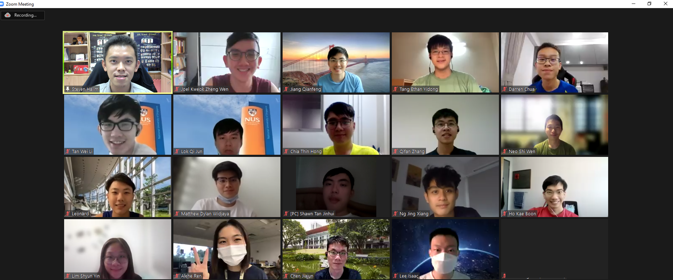
Let’s take a class final we-fie screenshot
Turn on your webcam if you consented to be part of this class picture (to be published in Class discord and my FB page later)
PS: Avoid putting matric number in your display name

Slide 15
THE END
for now… (see you in the finals)

